Slide 1

IMDB Feature Film Analysis
Team 02 - Deep Learner
Shuting Cai
Siddharth Das
Mrunalini Devineni
Yue Li

Slide 2

SMART Question:
What factors affect the IMDB movie rating?

Slide 3
Features
Movie Genres
Director
Movie Language
Movie Duration
Viewer gender
Viewer age
Movie Rating
Vote numbers

Slide 4
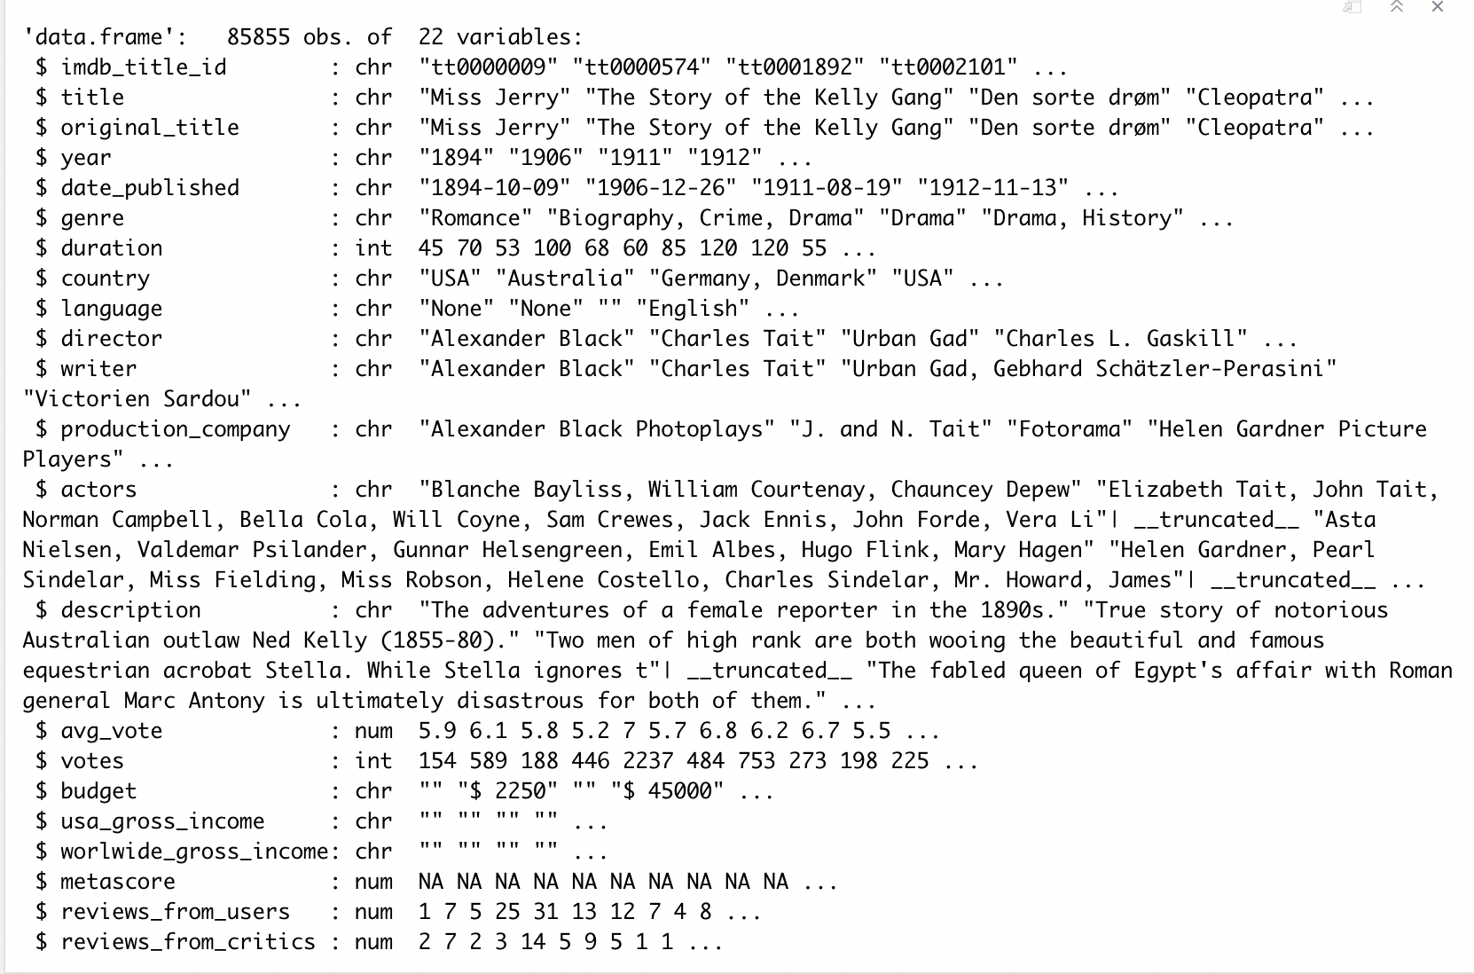
About the Dataset:
The dataset comprises of 85,855 movie instances of 22 variables
It also includes 297,705 cast instances corresponding to the movies

Slide 5
Exploratory Data Analysis

Slide 6
Preparation
Clean data: drop some columns
Remove outliers

Slide 7
Preparation
Dropped unneeded variables columns, dropped the rows with missing values
Subsetted the data used for the histogram
Test:
t-test
Graphs:
Histogram
QQ-plot
Barplot
Boxplot
Scatterplot

Slide 8
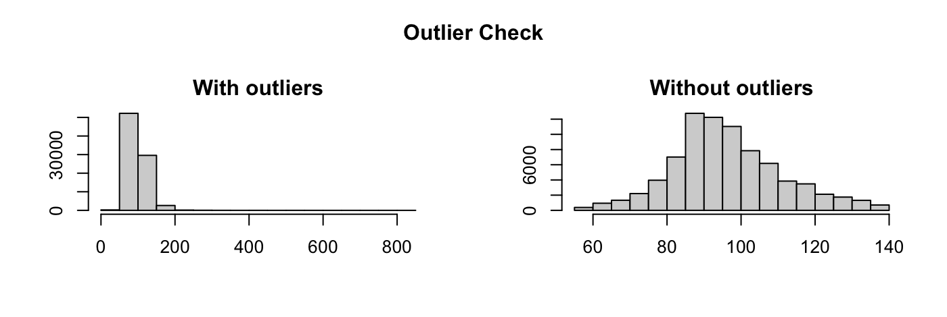
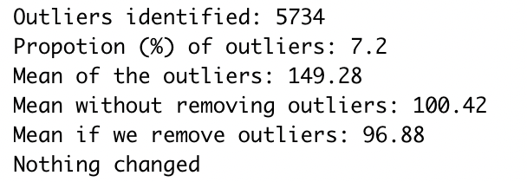
Outliers
Outliers- durations

Slide 9
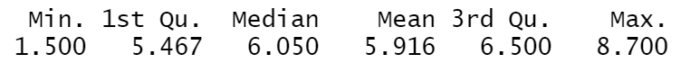
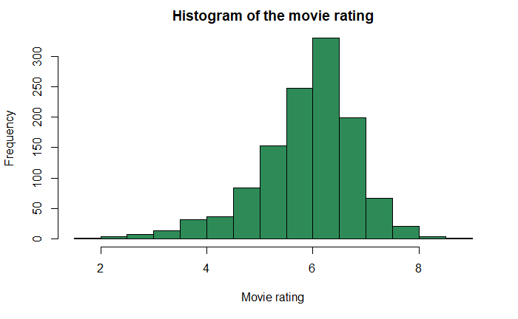
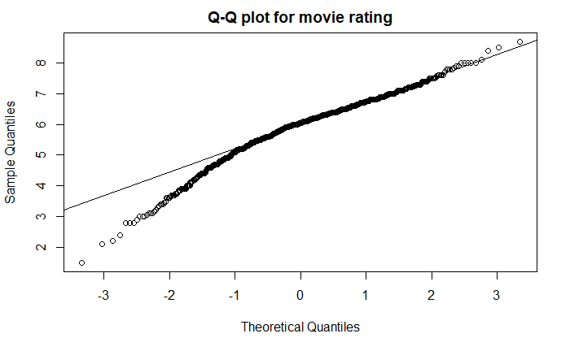
Movie rating & Q-Q Plot
Figure xx. The histogram plot of the movie ratings.
Figure xx. The Q-Q plot: Movie ratings.
Notes:
A brief overview of the dataset for movie rating: the minimum is 1.5, and the maximum is 8.7 out of 10; the mean of the movie rating is 5.916. From the histogram, we can see that the movie rating is left-skewed. Looking at the Q-Q plot, there is more data to the left of the Gaussian distribution. The points appear below the blue line because those quantiles occur at much lower values (the movie rating between 1 and 4) compared to where those quantiles would be in a Gaussian distribution (between 4 and 5).

Slide 10
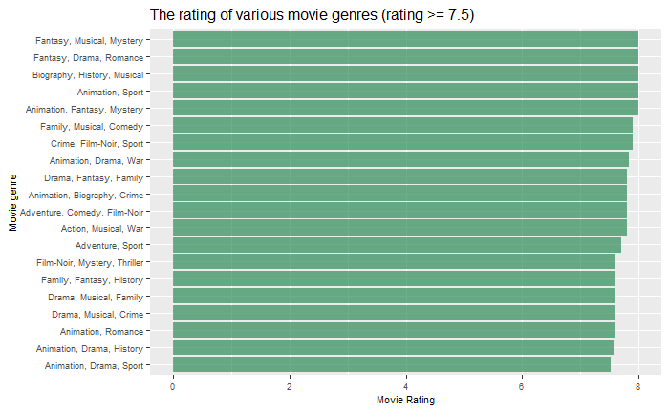
Notes:
Lets see what movie genres have the highest movie rating. From this bar plot, we can see there are top five have the same movie rating, that
Fantasy, musical, mystery
& Fantasy, drama, romance
& biography, history, musical
& animation, sport
& animation, fantasy, mystery.

Slide 11

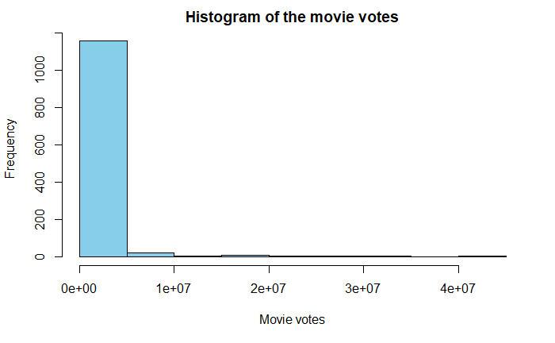
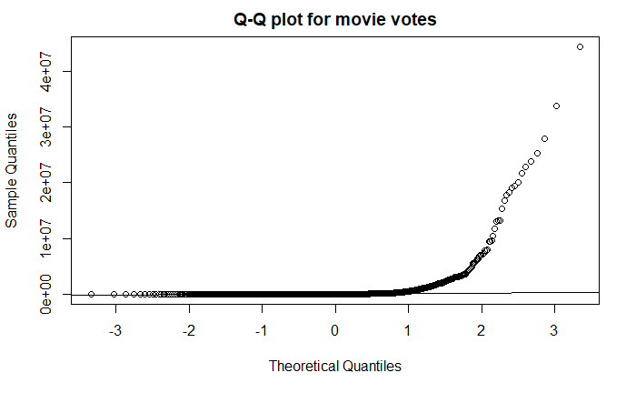
Movie votes & Q-Q Plot
Figure xx. The histogram plot of the movie votes.
Figure xx. The Q-Q plot: Movie votes.

Slide 12
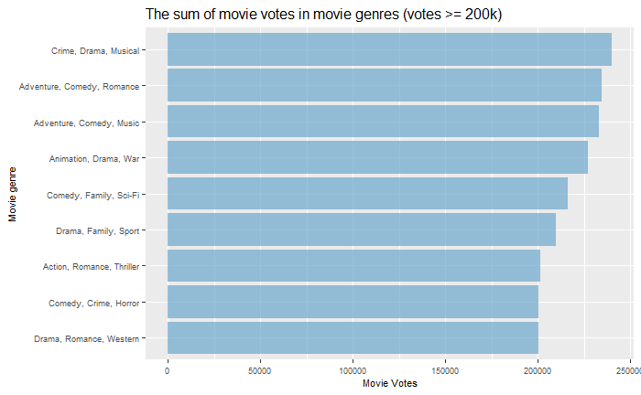

Slide 13
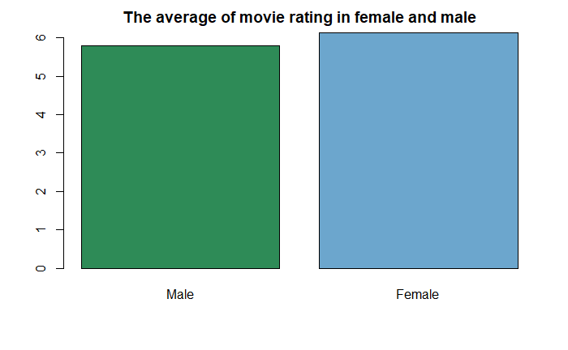
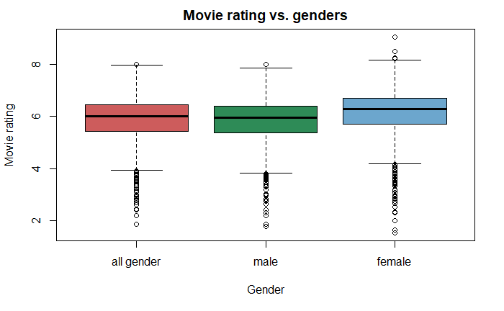
Do differences in genders have different average movie ratings?
Figure xx. The barplot for the average rating in genders.
Figure xx. The boxplot for the movie rating in genders.
Notes:
From the bar plot, the male and female have different mean of movie rating, and we can see that the movie rating from female is a little bit higher than male.

Slide 14
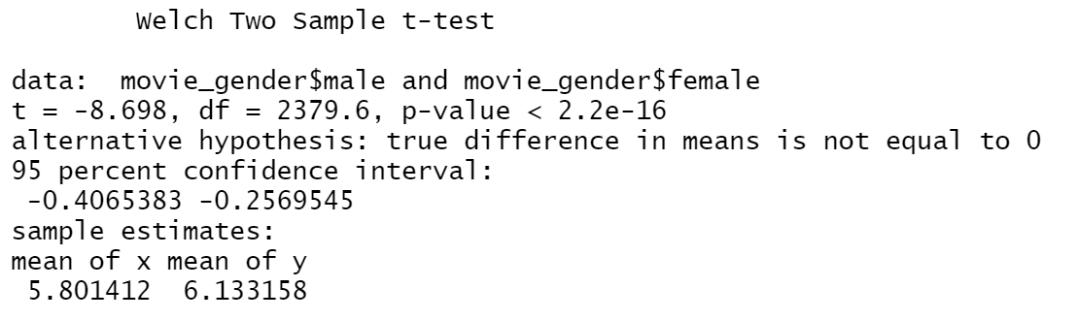
T-test for movie ratings in genders
Notes:
From the t test, the movie ratings in female and male are significantly different.
The average of movie rating for male is lower than female,
The average movie rating for male is 5.92, while for female is 6.27.

Slide 15
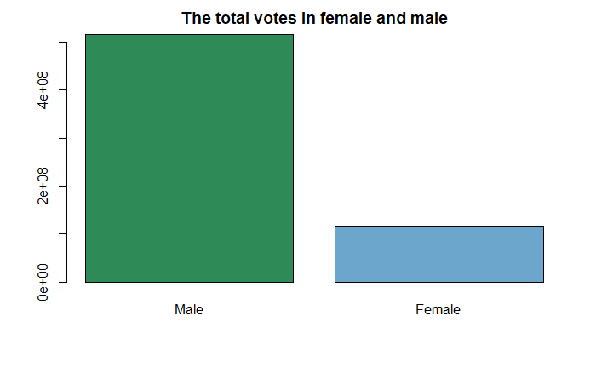
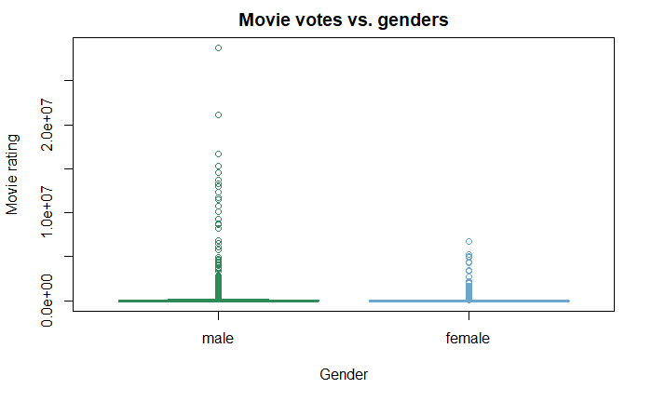
Do differences in genders have different amount of movie votes?
Figure xx. The barplot for the sum of movie votes in genders.
Figure xx. The boxplot for the movie votes in genders.

Slide 16
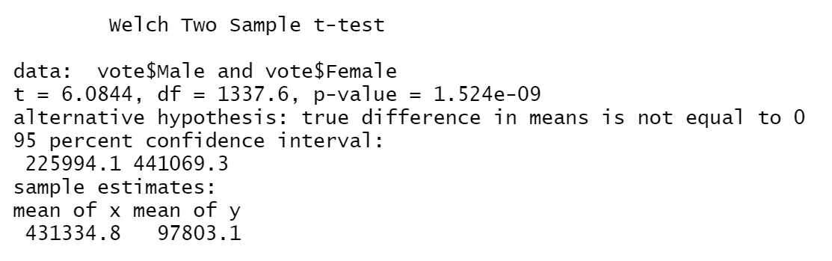
T-test for movie votes in genders
Notes:
The movie votes in female and male are significantly different.
The amount of movie votes for male is much higher than female, mean of movie votes for male is around 2590, while for female is around 537.

Slide 17
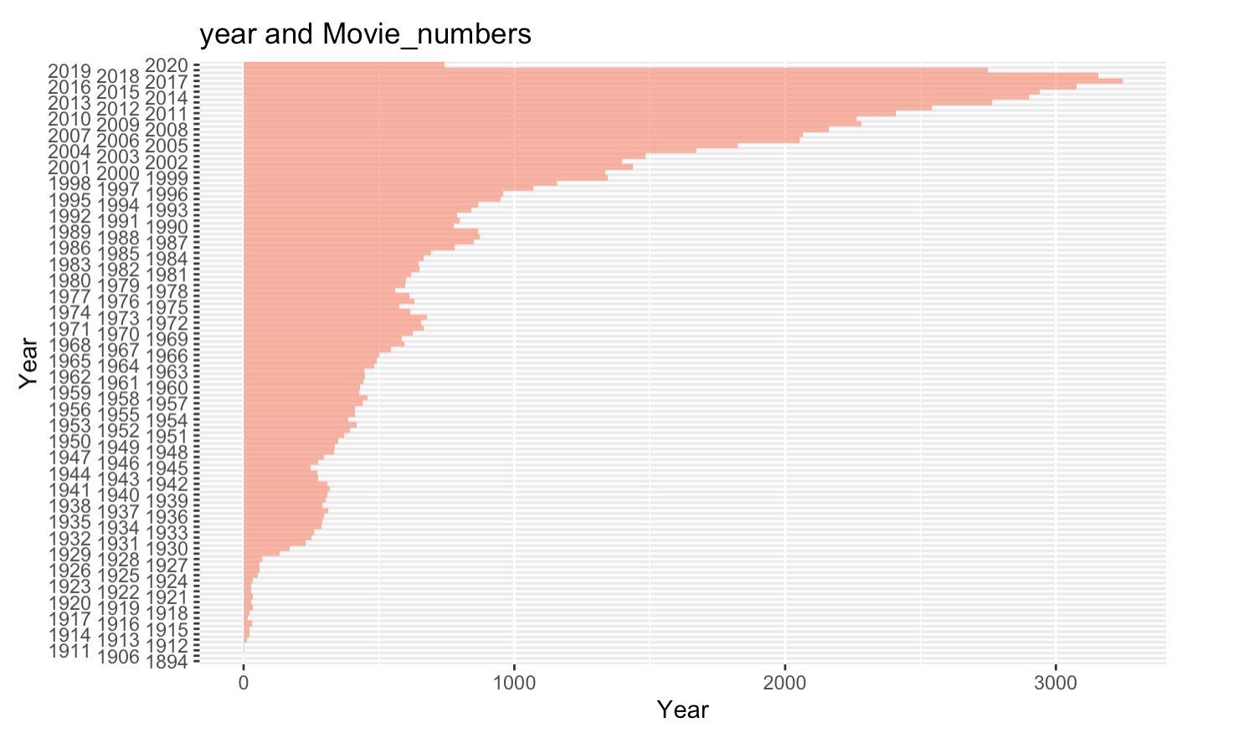
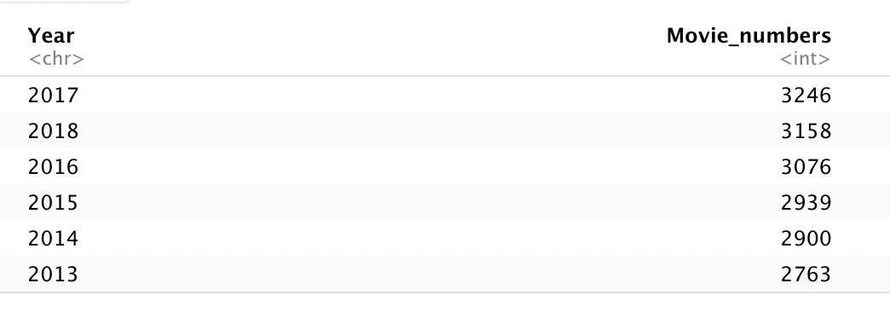
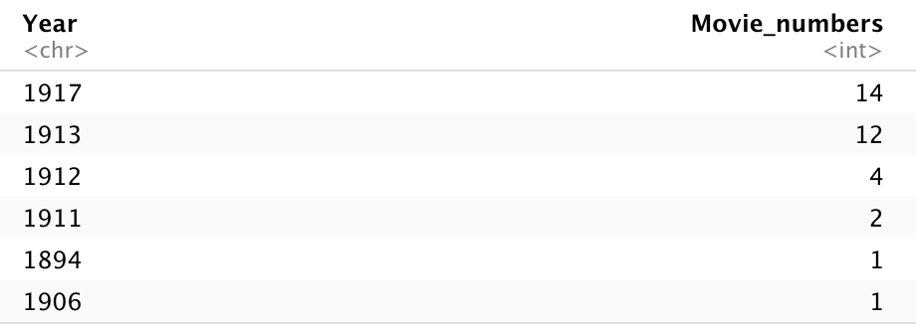
Movie numbers released in each year

Slide 18
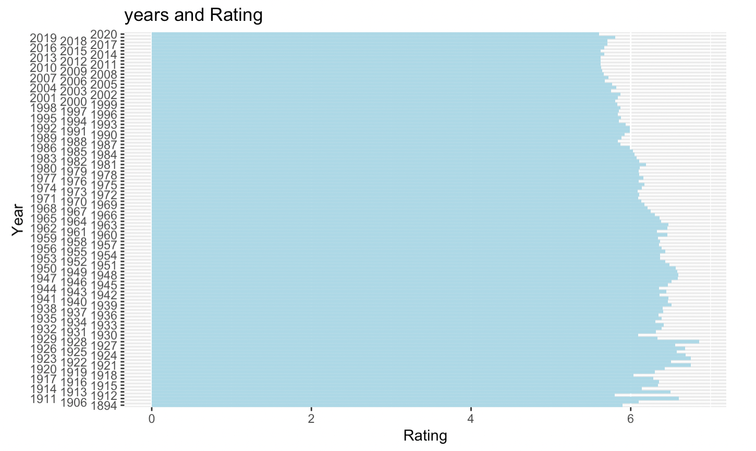
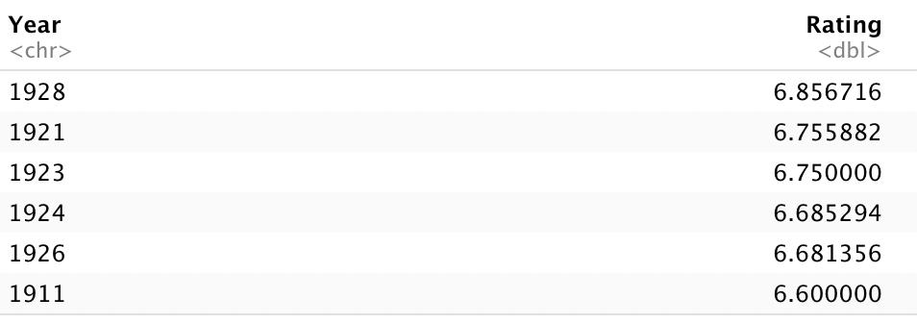
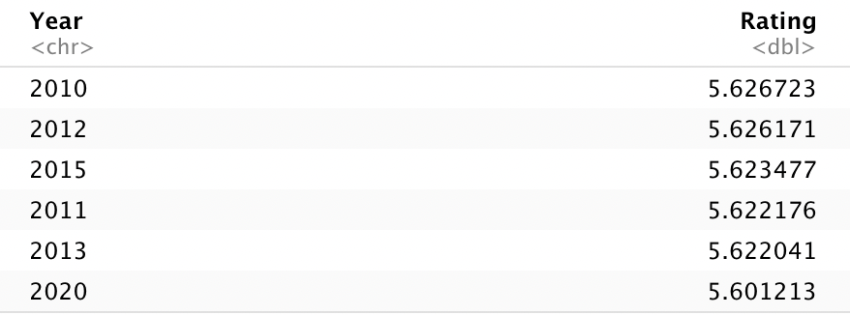
Mean of movie rating in each year

Slide 19
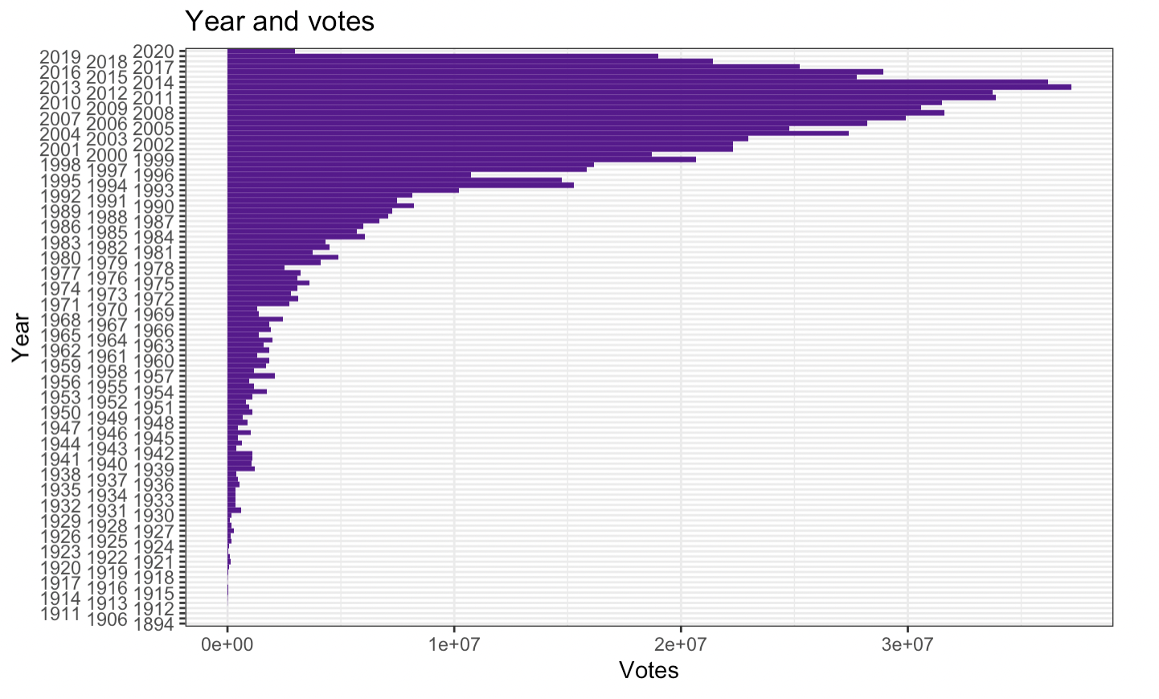
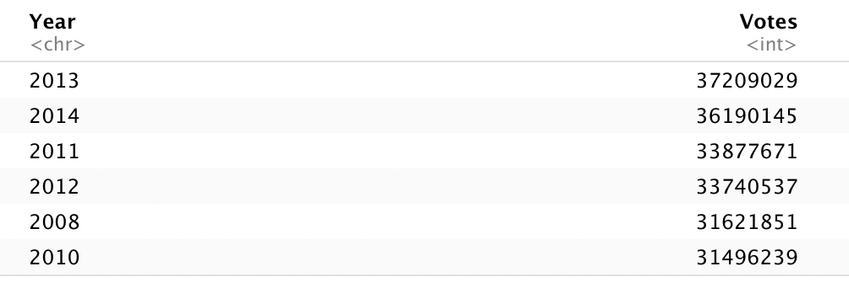
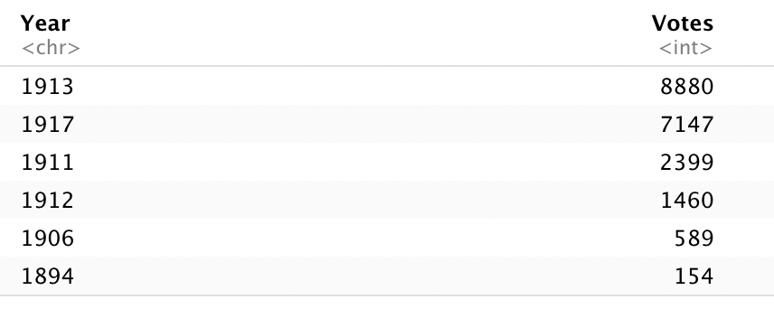
Sum the vote numbers in each year

Slide 20
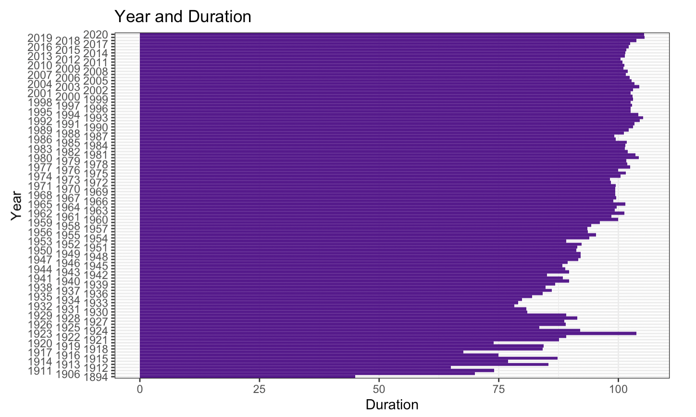
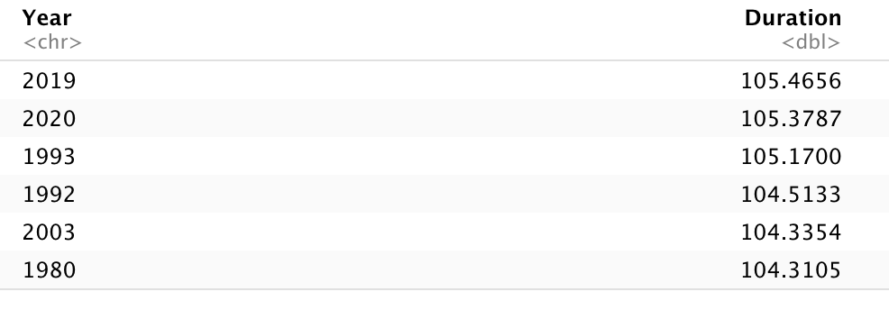
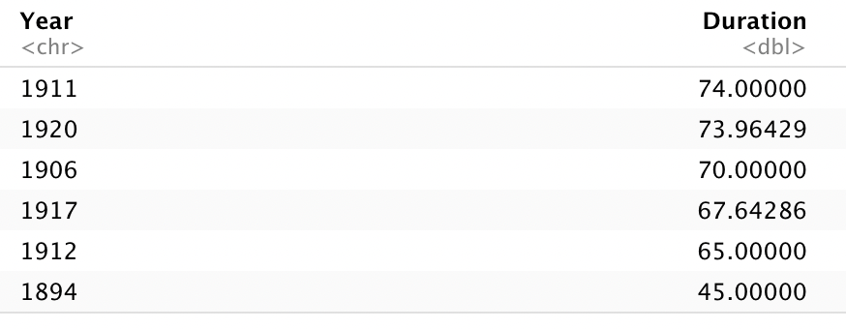
Movie duration changes in each year

Slide 21
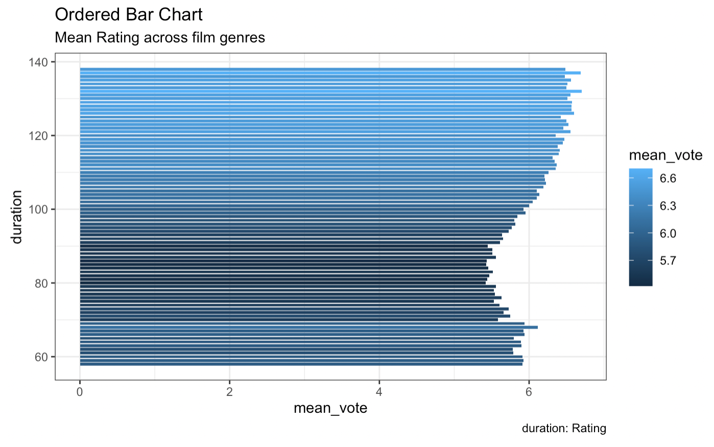
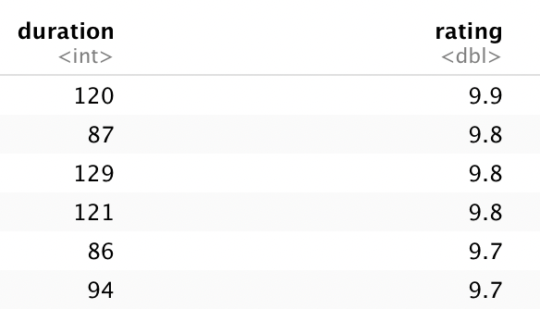
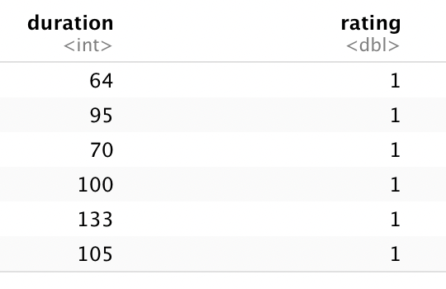
Movie duration and Rating distribution

Slide 22
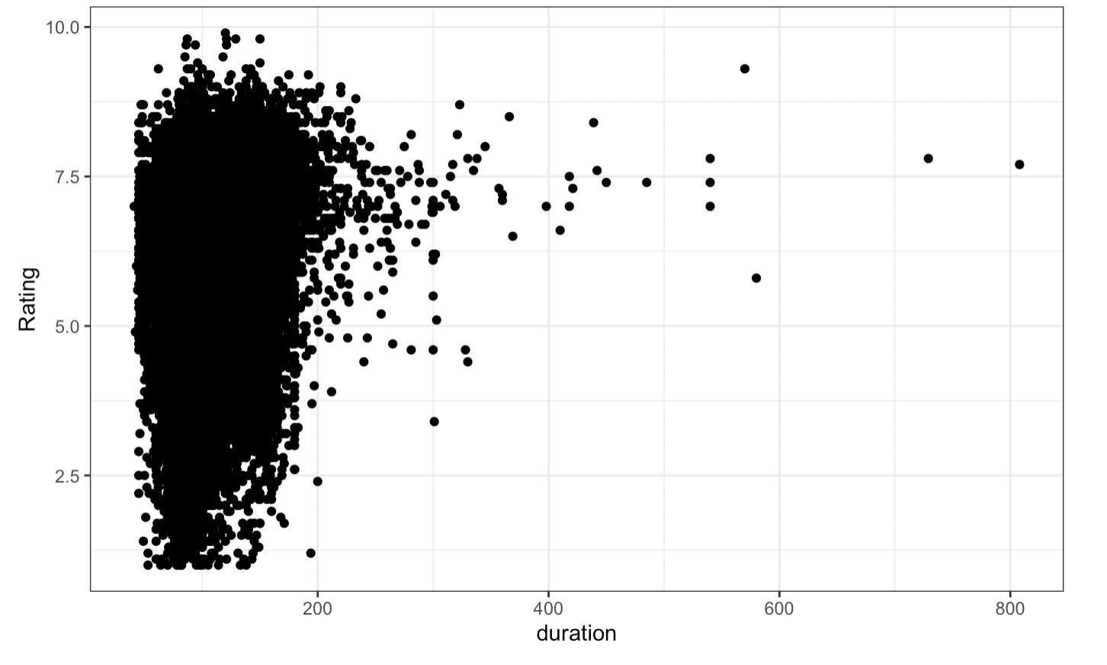
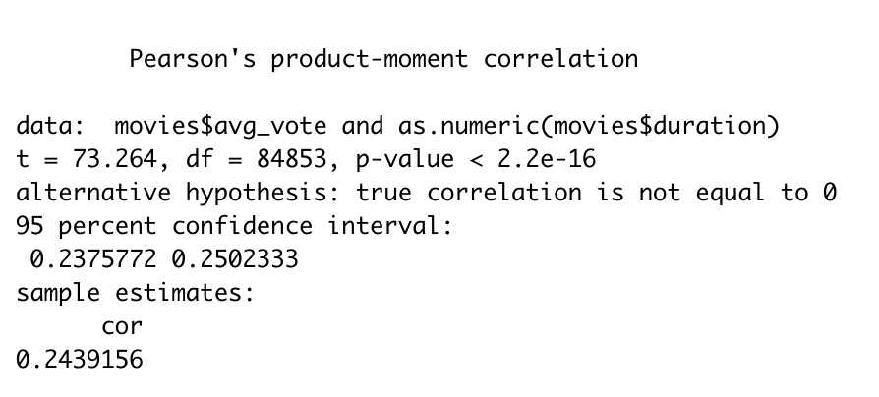
Cor.test : Duration and Rating
Cor:0.2439

Slide 23
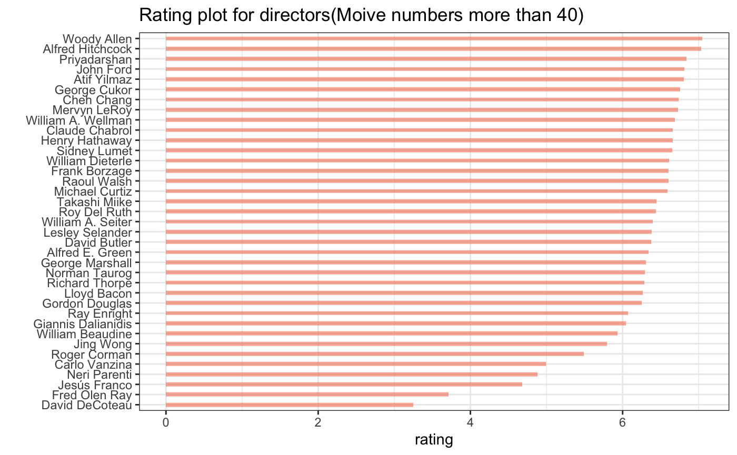
Mean rating for each directors
Woody Allen
Alfred Hitchcock
Priyadarshan
John Ford
Atif Yilmaz

Slide 24
Conclusions

Slide 25
References

Slide 26
Thanks for watching!

